Slide 1
Problem statement: Rabdi Wala wants to expand his business into newer dimensions(Online Market) over there strength of present scenario. Most effective and most efficient marketing strategy needs to be drafted.

Slide 2
SWOT ANALYSIS of “RABDI WALA”
Strength:
Variety in selection
Regular updates in Menu
Strong loyal customer base
No quantity and Time Restriction.
Weakness:
Lack of infrastructure in franchise model.
Proper delivery of sweets in online model.
Threats:
Minor peers who are expert in their particular sweet business
Spread of negative reviews if you are getting 65% revenue from Online aggregators.
Opportunity:
Large foodie population of Mumbai.
Increase in demand of traditional sweets in metro cities.
Major Youth population of the city.

Slide 3
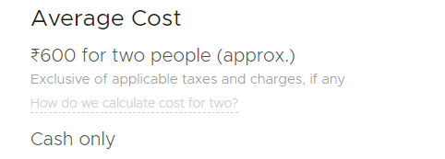

BREIF ONLINE REVIEWS ANALYSIS
Majorly considered Negative reviews in order to improve the service.
Data is from Zomato and Swiggy
Two different Average cost on different platform, it should be uniform.
Recommendations: - Cost for 2 according to average appetite of Indian consumer and according to your pricing on menu of “Rabdi Wala”, It can not be more than 300 for two.
- This recommendation is needed because average costs are written on top of this online platforms and it can highly affect the decision making of any spectator.

Slide 4
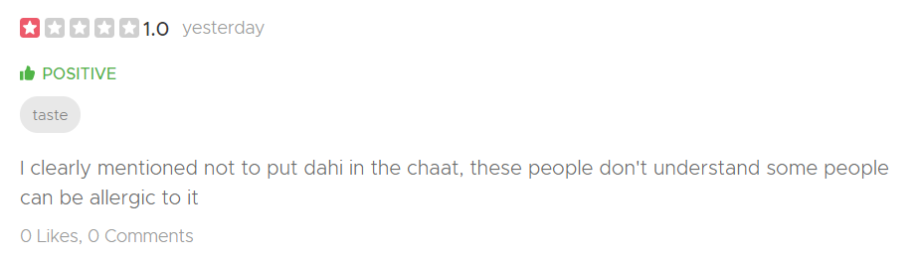
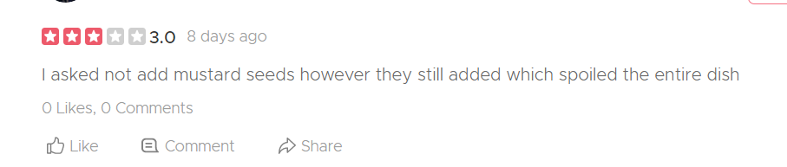
Key Points
- While preparing any order read the instructions carefully as if the customer found anything which was not supposed to be there in the dish no matter what the taste is, they will give 1/5 rating.
There were 30+ reviews, which was similar to this.

Slide 5
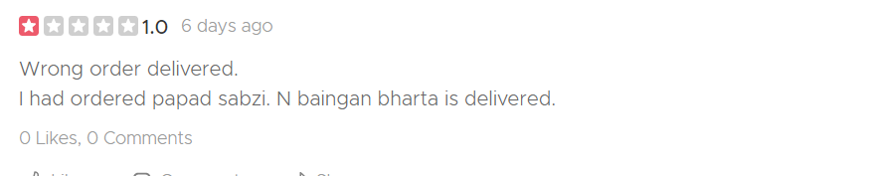
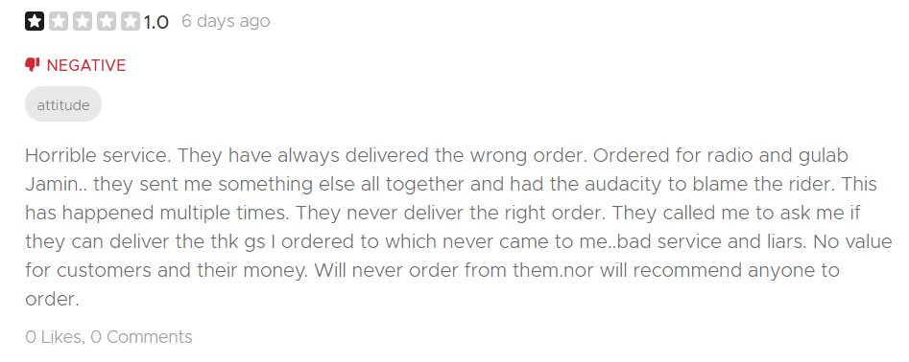
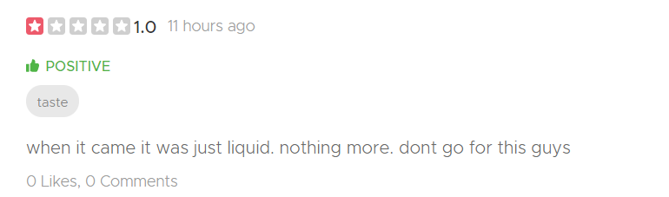
Key Points:
- Online delivery and services should also be at same level of dining facilities.

Slide 6
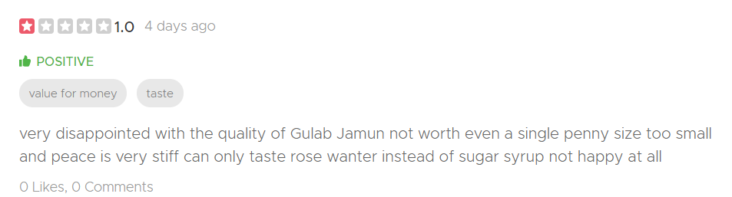
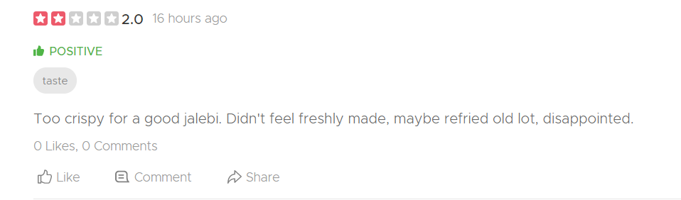
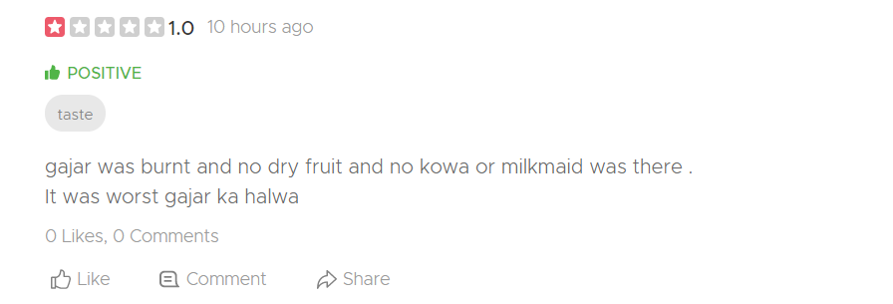
Key Points:
Always show what it is in actual.
Major decision maker is the picture of the food on online platforms and if the image is beautiful vs it is actually provided then it’s a disappointment.

Slide 7
Analysis Problem Findings.
Overall ratings were above 4.3/5 (summing up all reviews on internet).
Strength of Rabdi Wala is its Taste which is unbeatable.
When it comes to online delivery there are various challenges that needs to be addressed such as
Food Packaging
Wrong Delivery of food.
Food gets cold in home delivery.
Specific Instructions are ignored while preparing online order.
False Image in comparison to real food.
Biased average pricing on different platforms.

Slide 8
Analysis Solution
Regular check the reviews of online delivered food and providing quick response to negative reviews must be the priority.
Packaging should be authentic and hygienic, no leakage of food or high temperature difference between store to delivery destination.

Slide 9
What marketing strategy should Anurag use to expand his brand, Rabdi Wala, in
the present scenario?
Solution:
Use “Rabdi Wala” Brand Containers for Food.
Capture clips of customers reviewing your food and post it on all social media handles.
Guerrilla marketing at functions/events and giving free dish if they click selfie and post it on there social media.
Team up with travel & Food influencers.
Provide Glutton free & sugar free variant in order to specify healthy foods.
Create blogs and maintain.
Franchise Marketing
Use all above strategies in franchise too.
Emphasis Word of Mouth marketing.
Every Branch should have Unique mailing strategy.
Brand Image consistency must be there.
No compromise at quality.
Flyer in all local news papers in the area of franchise.

Slide 10
2. How can precision market segmentation and targeting be used by Rabdi Wala to
drive revenues? Solution: Strategies provided below are based on segmentation which when applied will eventually give a raise in overall revenue.
Market Segmentation:
Geometric Segmentation: Change in Menu according to location
People will find specific item in particular store only.
Which will create uniqueness of each store.
Demographic Segmentation: Observe buying behavior of customer based on their age and gender.
Young population(15-25) buys differently and different product than adults or old people.
Different occasions/events/functions have their specific needs offer them that.
Psychographic Segmentation:
Sponsoring food stalls in sports event vs corporate event has different requirements, as the attitude toward your food differs a lot on situation.
Behavioral segmentation:
Loyal customers has to be given extra care and discounts as they are your free marketing contents.(they emphasis on mouth of word marketing).
Create an image of “ Rabdi Wala is not food its an emotion”.

